Slide 1
DIGITAL FORENSICS INVESTIGATION REPORT
REQUESTED BY: DR. VIRGINIA FRANQUEIRA FROM THE UNIVERSITY OF DERBY
DATE: 19TH APRIL 2016
INVESTIGATOR: BADE-ADEBOWALE KEHINDE
CASE: DIGITAL FORENSIC INVESTIGATION OF THE EVIDENCE AQUIRED FROM THE DEFENDANT MR. SAM MALONE, BEING INVESTIGATED FOR ILLEGAL WIRE TRANSFER AND ILLEGAL WEAPON TRADING
CASE NUMBER: Malone_2016_Derby
DEFENDANT: MR. SAM MALONE

Slide 2
evidence & Aim of digital forensics investigation
Aim of investigation
Identify activities of illegal wire transfer to off-shore institutions
Identify activities of illegal trade of weapons
Activities aiding I and II
Evidence
Image File: Malone’s HDD 1A.E01

Slide 3
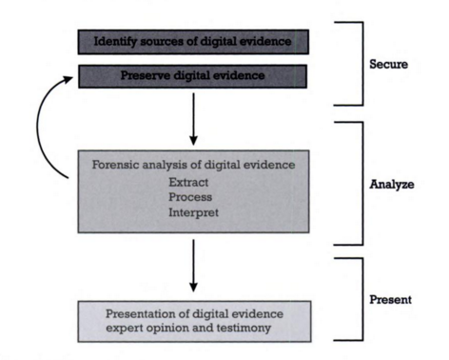
CFSAP MODEL as METHODOLOGY
computer forensics secure analyze protect model

Slide 4
Acpo good practice guide for digital evidence
Made sure the handing of evidence followed the ACPO guide
Link to the ACPO guide http://www.digital-detective.net/digital-forensics-documents/ACPO_Good_Practice_Guide_for_Digital_Evidence_v5.pdf

Slide 5
Evidence preservation and verification
Evidence preservation
Evidence was stored in a write proof location
Evidence Verification
Used encase to verify that Acquisition and Verification are the same for the SHA1 and MD5 hashes

Slide 6
Time zone configuration
Time zone of the evidence file was Pacific Standard Time (PST)
Changed the time zone of the machine environment of the investigator to PST.

Slide 7
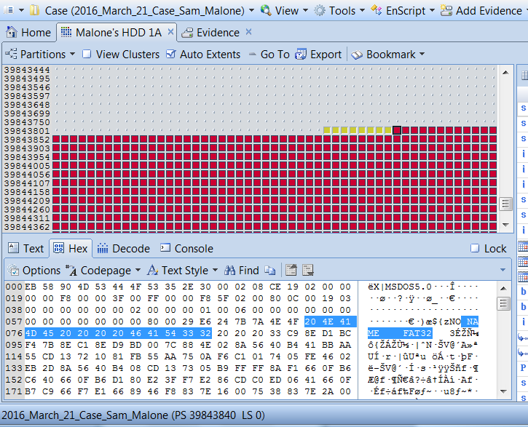
Disk analysis
Deleted partition detected
Retrieved and Added deleted partition

Slide 8
Email analysis
Mr. Sam Malone acquired from Mr. Cliff Cavin the following
Ordinance and Weapons Acquisition Tracking software (OWAT)
Predator type drones support and upgrades.
Payment was made by Mr Sam Malone Acquired to Mr. Cliff Cavin
Amount $22,950,000,000.00
Account Number: 89-2384993947
Bank Name: Bank of Antiqua

Slide 9
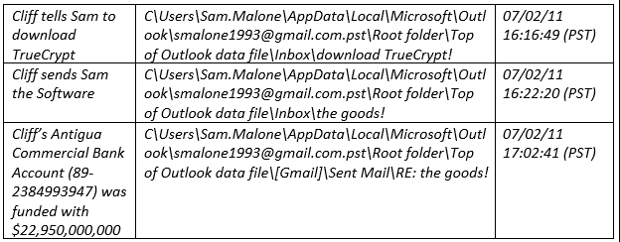
Email analysis (Cont.)
Parties | Name | Email | Time Frame
Defendant | Mr. Sam Malone | smalone1993@gmail.com | 29/01/11 18:38:14 (PST)
Seller | Mr. Cliff Cavin | cliffcavin39@gmail.com | 07/02/11 16:31:05 (PST)

Slide 10
Internet artifact
Frequent searches for pictures relating to explosion
Frequent visits to www.t0.gstatic.com (House several pictures of explosions)
Two visits to www.truycrypt Site used for the software encryption

Slide 11
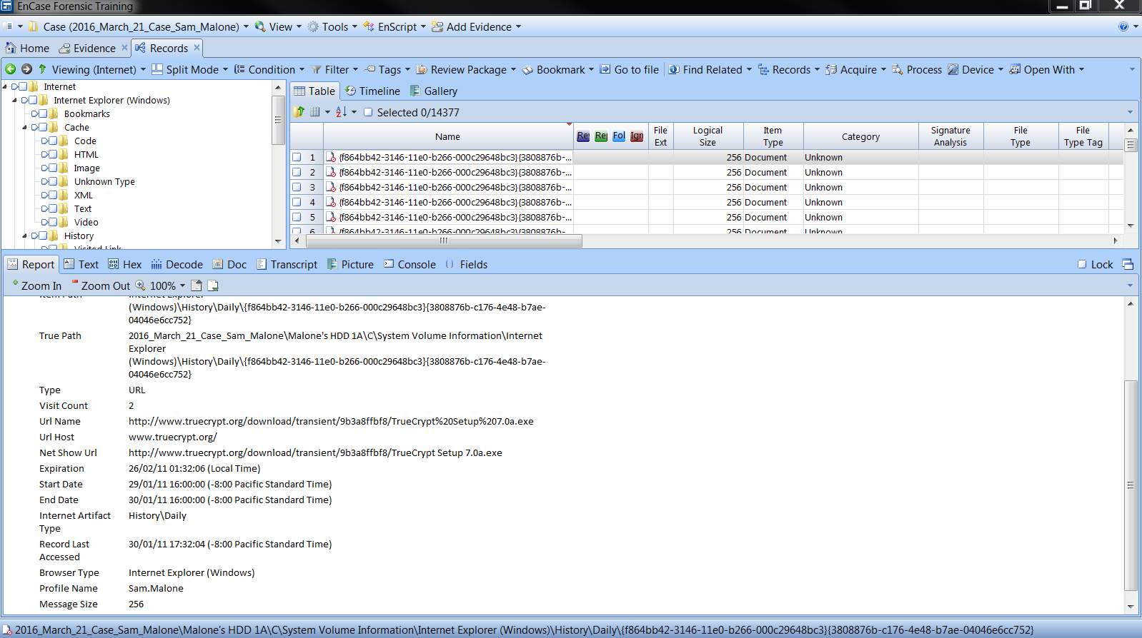
Internet artifact
Site used for encryption true crypt

Slide 12
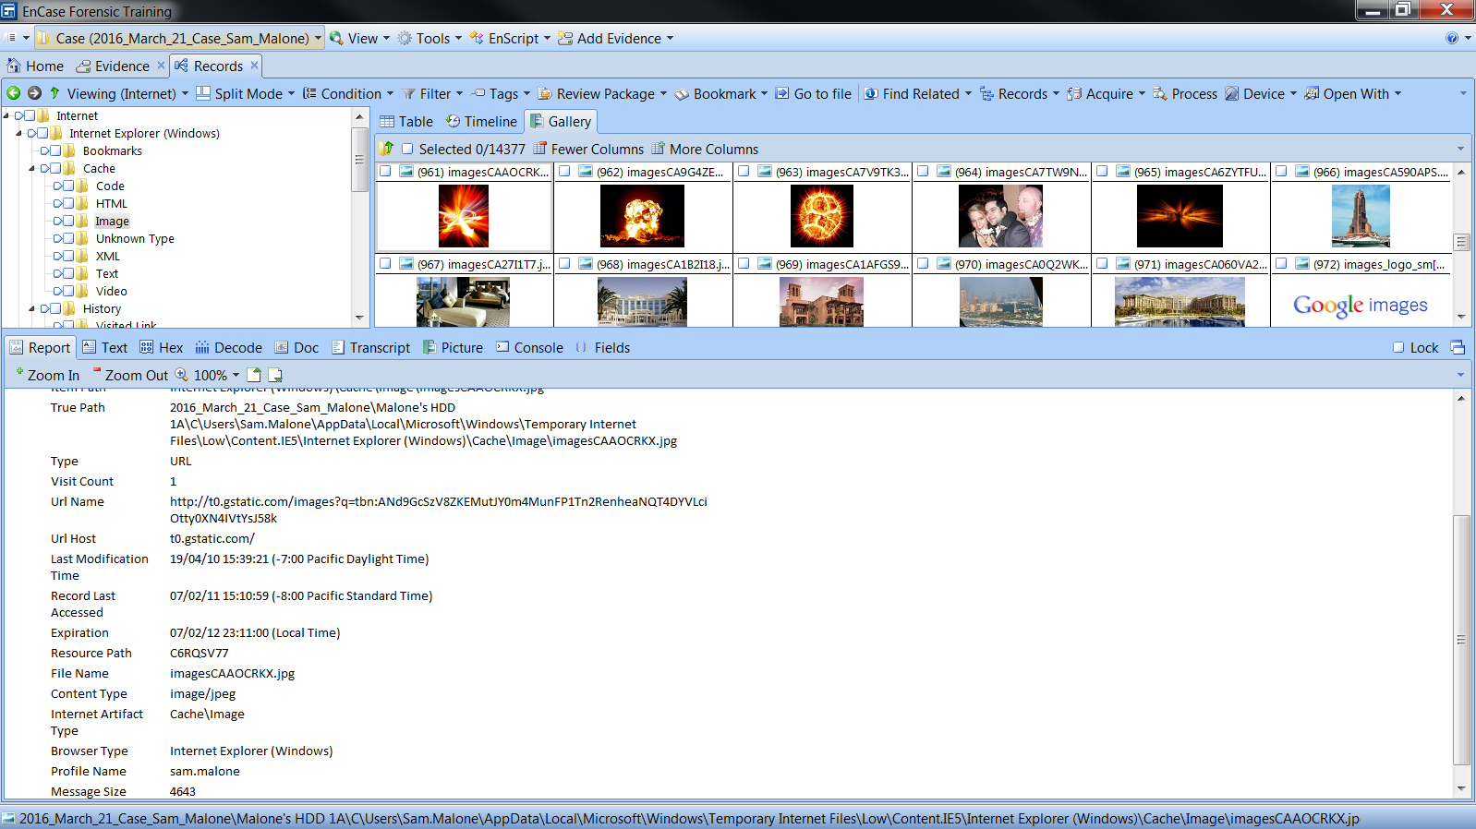
Internet artifact (cont.)
Searches for explosives

Slide 13
Analysis of the e drive
Suspicious folders in the E drive
Received $1,550,999,000.00 from terrorist organization Al Qaeda in total
Frequent travels to the middle east
Encrypted folder called “OWAT Software for al qaeda”, which suggests that the OWAT software is accessible by the terrorist organization
Statement of account indicating huge transfer of funds through third parties

Slide 14
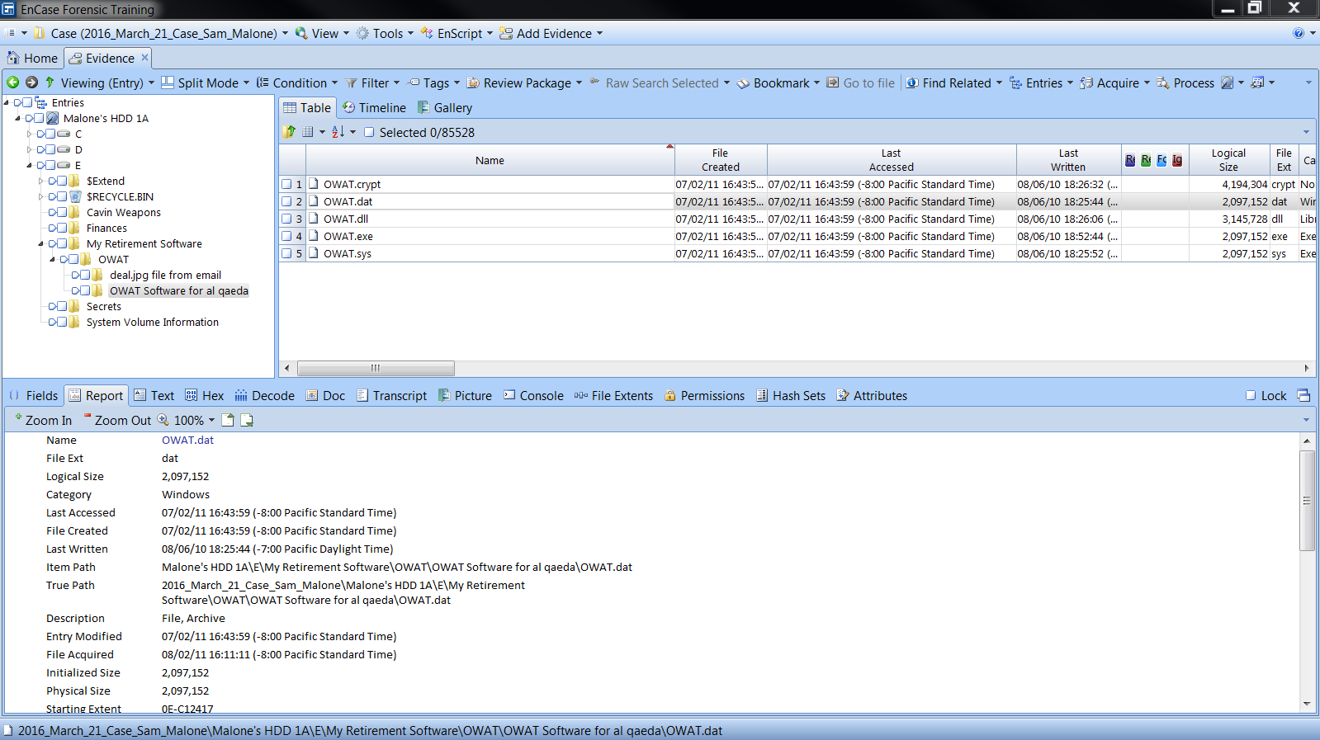
Analysis of the e drive (Cont.)
Suspicious folders in the E drive

Slide 15
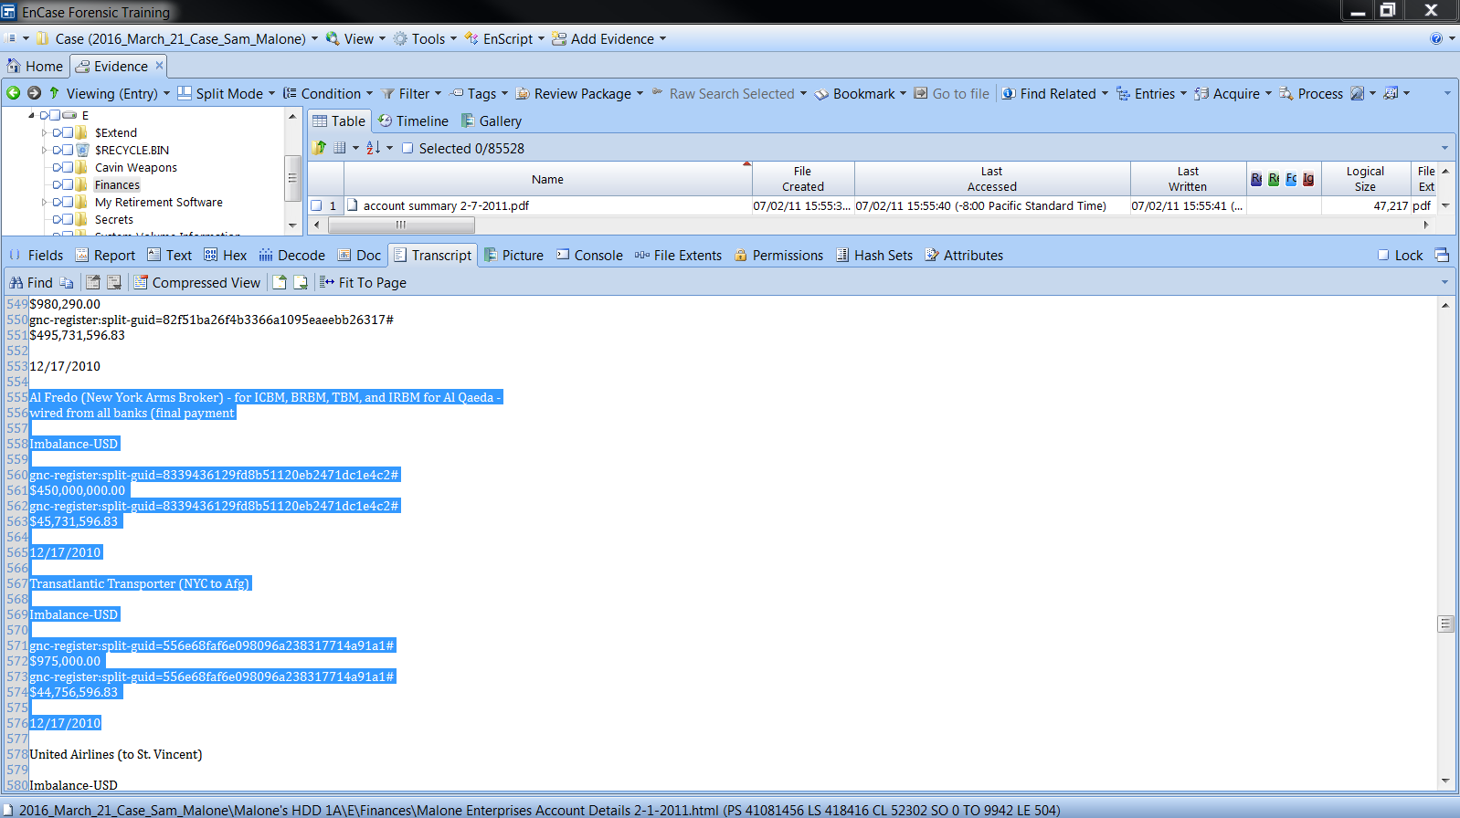
Analysis of the e drive (Cont.)
Received $450,000,000.00 from Al Qaeda through New York Arms Broker (Third Party)

Slide 16
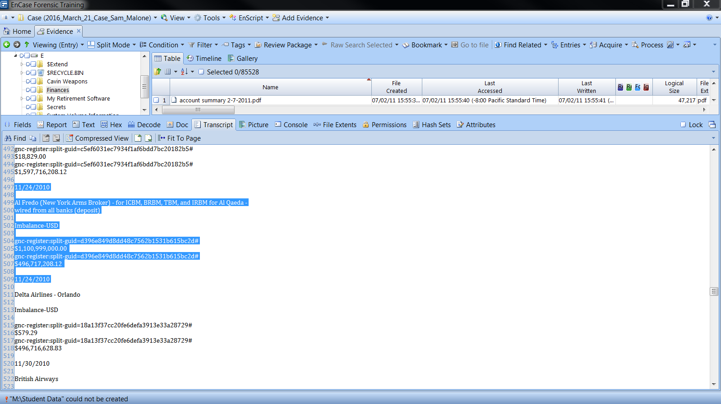
Analysis of the e drive (Cont.)
Received $1,100,999,000.00 from Al Qaeda

Slide 17
conclusion
From my expert standpoint I can deduce that:
There were activities of illegal trade of weapons and illegal wire transfer of funds to offshore accounts.
Payments were also made for an “Ordinance and Weapons Acquisition Tracking Software (OWAT)” into Mr. Cliff Cavin’s company account.
There was an encrypted folder called “OWAT Software for al qaeda” (name of a terrorist organization) suggesting information secretive to Mr. Sam Malone with regards to his dealings with this organization
Received as much as $1,550,999,000.00 from the terrorist organization

